Slide 1
Module 4
PRACTICE IS BETTER THAN IDEAS

Slide 2
Agenda:
The motivation behind the Engagement
Concrete cases > ideal visions
Break 5 min.
Participatory Methods
How to get inspired by others

Slide 3
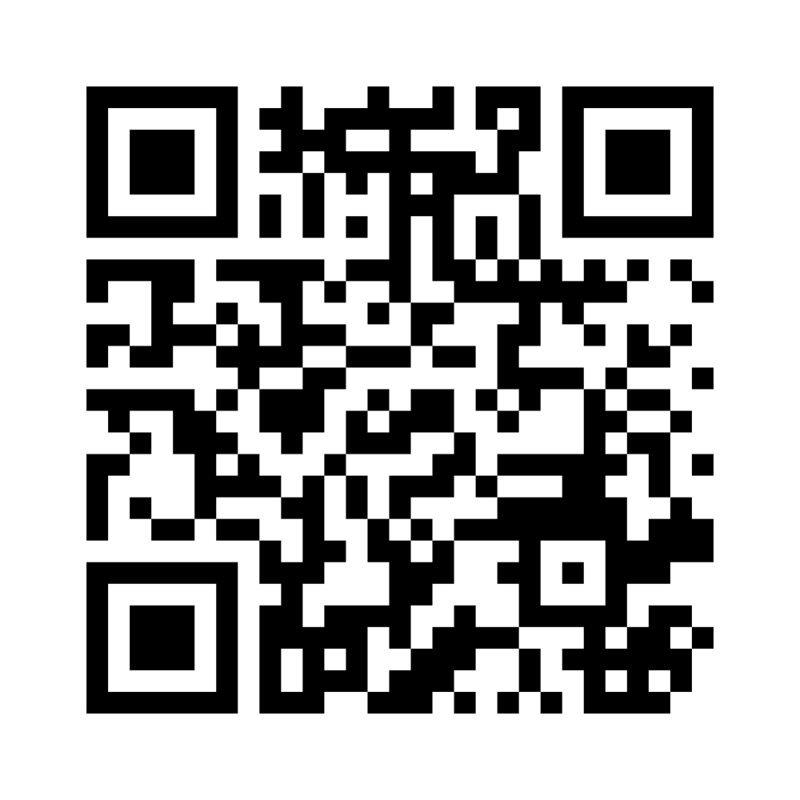
find your motivation
What motivates you to act against climate change?
What gets the people in your community motivated?
What do you need to be motivated?
VIDEO
Notes:
MENTIMETER: https://www.menti.com/almqy5oeicm9

Slide 4
Concrete cases > ideal visions
Only by investing in human and social capital, in communities and in everyone’s relationships and biographies, we can generate a social impact intended as a change for people’s lives.
That’s why concrete cases are usually better inspirational examples, because it is starting from a local community and its needs and resources, both in terms of goods and people, that innovation is developed.
Best practices are important for processes that you need to work correctly. They are the best way to do things and have been worked out through trial and error, and are found to be the most sensible way to proceed.

Slide 5
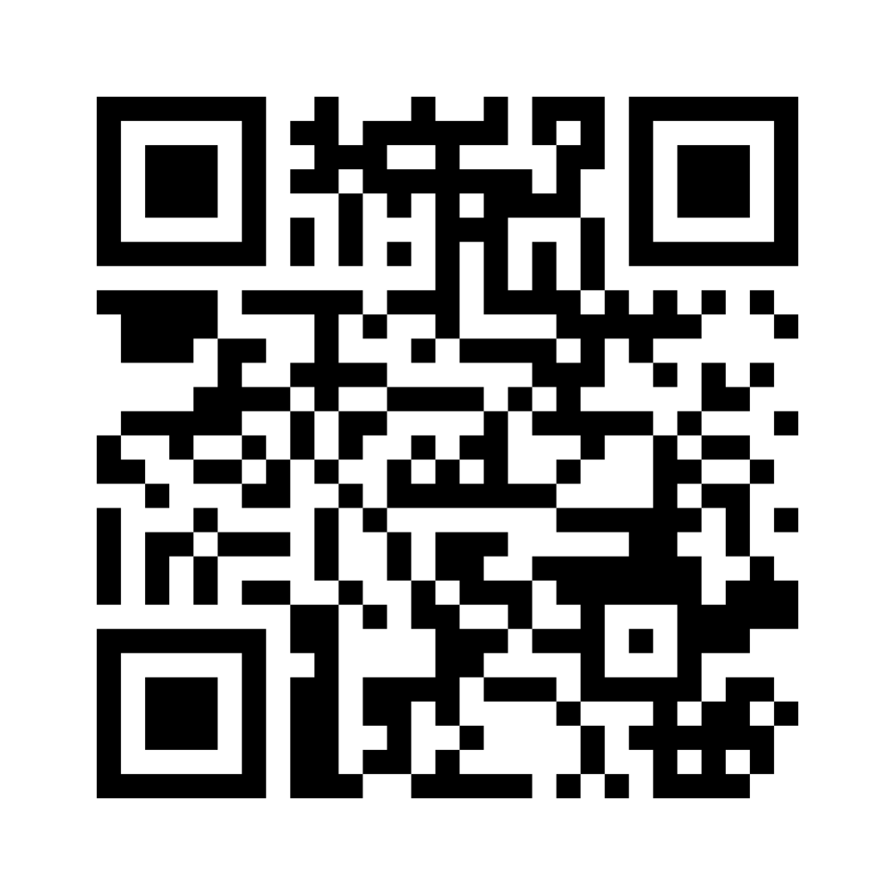
We can all be changemakers
What changes would you like to see in your community?
Notes:
SLIDO
https://app.sli.do/event/631qTK4BqVVrhKz8599Pef/embed/polls/d46e8c2e-3037-40da-aa92-43e3cdca18be
https://app.sli.do/event/631qTK4BqVVrhKz8599Pef/embed/polls/93cdd0a9-aedd-45db-9469-e9463d3587c3

Slide 6
BREAK TIME
5 MINUTES

Slide 7
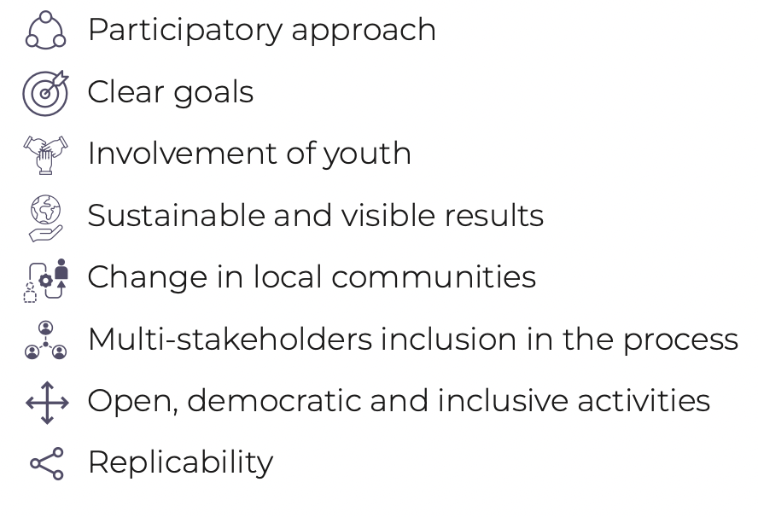
THE RECIPE BOOK
Common features of best practices

Slide 8
Let’s divide in groups
Read the best practice
Discuss among you
Fill in the boxes on Miro
Let’s get back and share
Notes:
DO MIRO

Slide 9
THANK YOU!

