Slide 1
Module 2
CIVIC ENGAGEMENT AND YOUTH

Slide 2
Agenda:
Youths as Agents of Change
Civic Engagement
Community Building
Participatory Methods
Theory of Change

Slide 3
Youths as Agents of Change
Who are the Agents of Change?
An Agent of Change is a multi-disciplinary figure, animator-designer of the territory. His/her actions are:
involving the actors on the territory in the realization of development projects aimed at creating local 'value’.
promoting, making concrete and enhancing the growth opportunities of a local community.

Slide 4
Youths as Agents of Change
What actions can you as an individual take for your territory (to combat climate change)?
Give me your opinion on Mentimeter.
https://www.menti.com/aledoo6cfbio

Slide 5
What is Civic Engagement?
''Civic engagement is when people join together and take action on issues of public concern’'
It can include initiatives to “organize” action groups, “participate” in community agencies, “advocate” issues in a school board or city council, and other approaches.

Slide 6
Civic Engagement
Who is your community?
Let me know on Mentimeter!
https://www.menti.com/alsigiomiez7

Slide 7
Community Building
Community building is a field of practices directed towards the creation or strengthening of a community.
The latter is defined as a group of individuals within a regional area, such as a neighborhood or a city.
A community can also be formed by a common need or interest, such as climate change.

Slide 8
Community Building
What can you do to strengthen, promote and engage your community?
Let me know on Mentimeter!
https://www.menti.com/alvix1xq8uqn

Slide 9
Participatory methods
There are several differences on the level of participation an individual or a community has, based on why they get involved.
Three have been highlighted:
A. Providing information;
B. Consultation;
C. Active participation

Slide 10
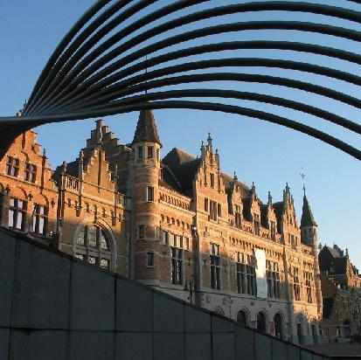
These are some of the participatory methods that can be used, such as:
Digital referendum in Kortrijk, Flanders
Polling participation method
In October 2019, in the Flemish city of Kortrijk, the city administration decided to ask the opinion of the city's inhabitants on the implementation of a monthly car-free Sunday in the city center. It did so through a digital referendum, the first of its kind in Belgium.
''Poll participation method''
It involves questioning a specific topic, predefining possible answers and letting citizens choose their preferred option.

Slide 11
Paris and the participatory budgeting method
Paris introduced participatory budgeting to increase residents' involvement in municipal decision-making and to allocate funds more efficiently. The initiative led to the implementation of numerous projects proposed and voted on by residents.
‘'Participatory budgets'’
are a very powerful participation tool, as they directly involve citizens in the process of allocating municipal budgets. Citizens choose the projects in which they think the city should invest, using the specially allocated funds.

Slide 12
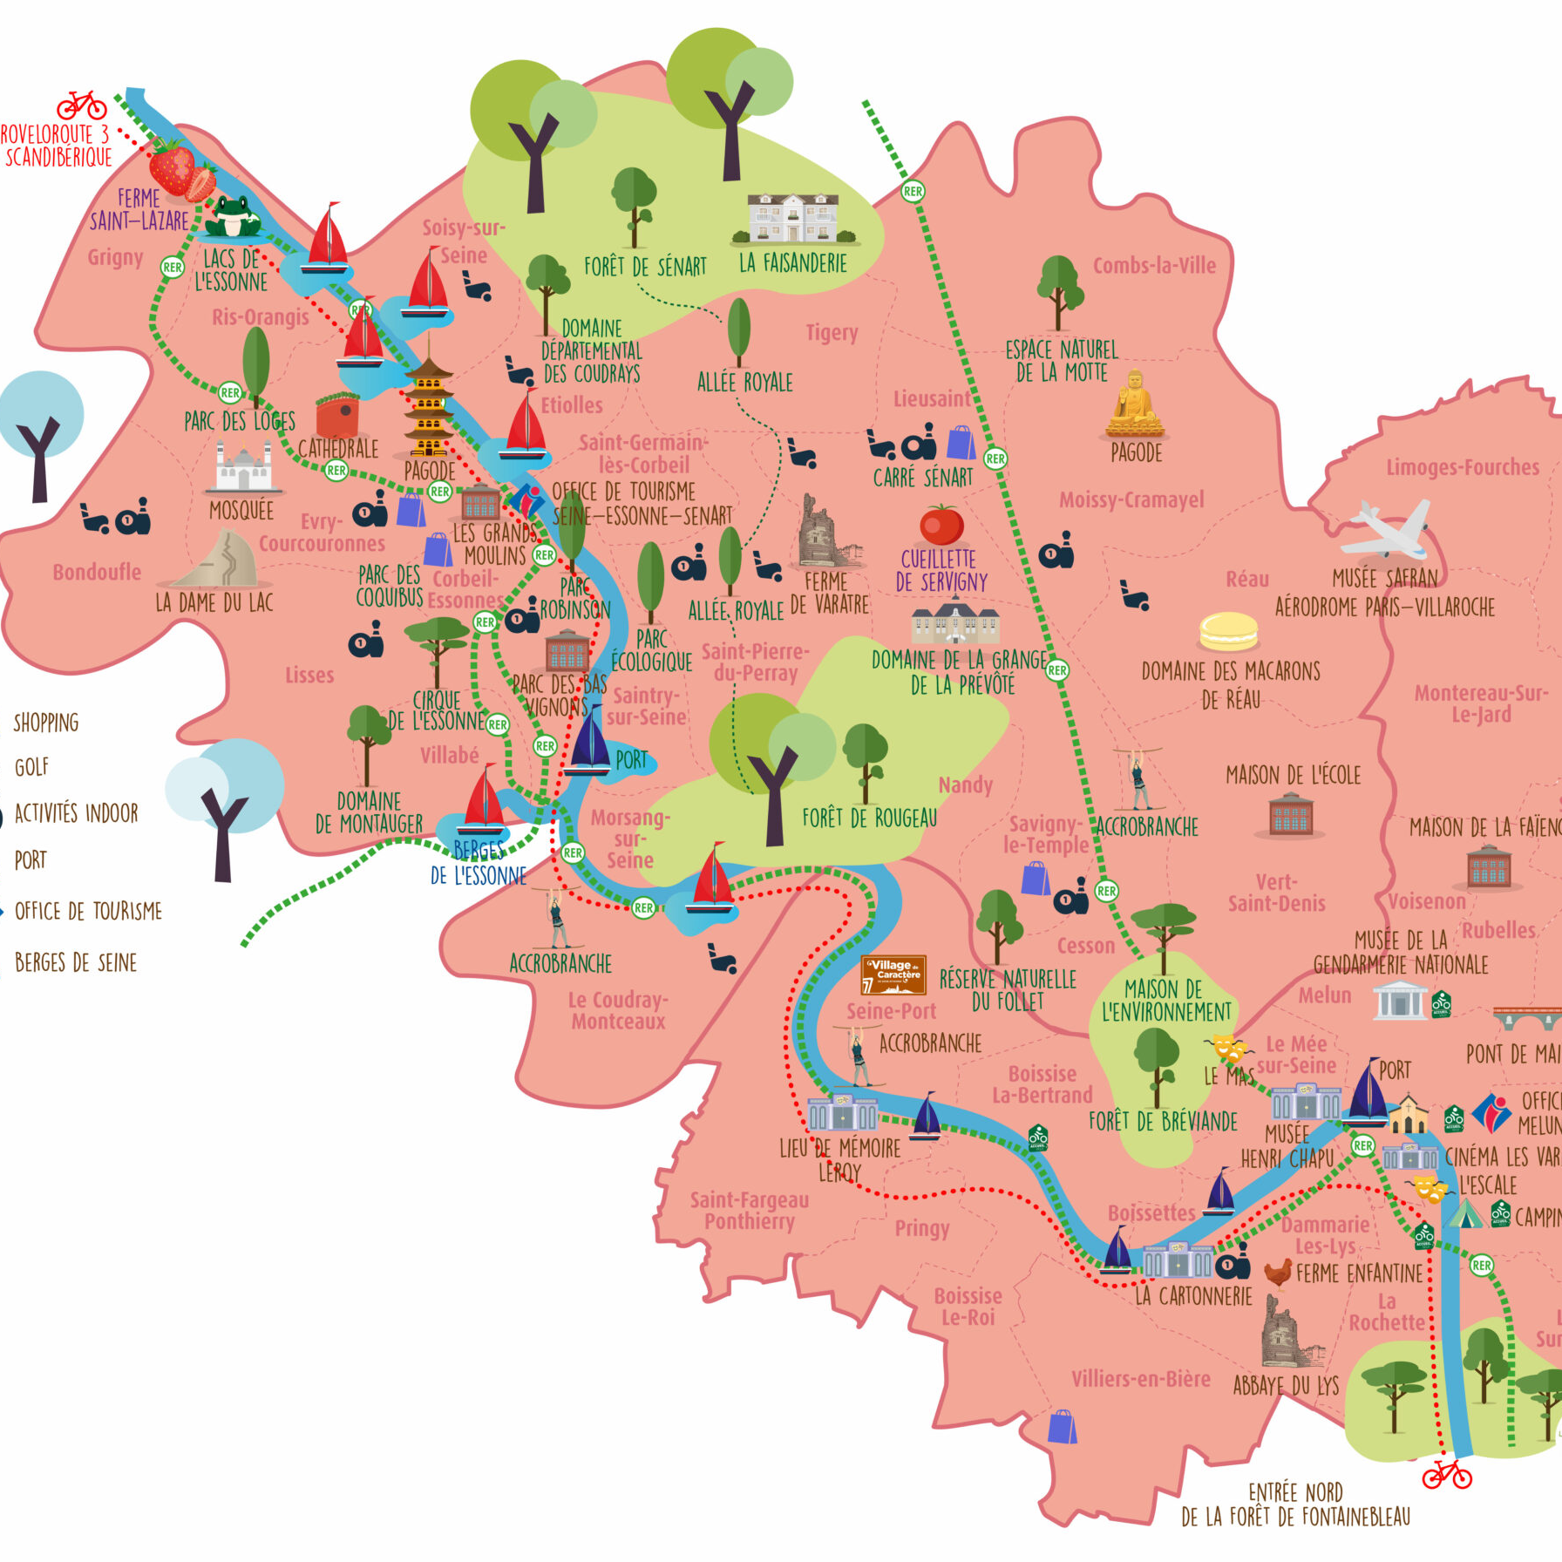
Grand Paris Sud and participatory ideation process
Grand Paris Sud used this process to gather new ideas from its inhabitants on three areas of its strategic plan: cycling, environment and culture.
The ''ideation process''
is a way for cities and municipalities to approach citizens for new ideas on predefined topics. The collection of ideas is a more complex process than a simple vote and requires greater citizen involvement.

Slide 13
Theory of Change
Theory of Change (ToC) is a critical thinking approach to program design, monitoring and evaluation that has become increasingly influential in international development.
ToC outlines the building blocks and the relationships between them that would lead to the realization of a long-term goal.
It is flexible and practical in that it clearly articulates a vision of meaningful social change and then systematically outlines the specific steps to achieve it.

Slide 15
Identify the Long-Term Outcome
''It is necessary to be clear what the final objective is to be achieved even by breaking it down into various points that must be as simple as possible.
This avoids vague and confusing statements and makes it easier to identify the necessary elements for the next steps''

Slide 16
Develop a Pathway of Change
''This step is used to identify and sort out all the preconditions related to the ultimate outcome of interest into a pathway of change.
The pathway of change should be designed via backwards mapping.
The team should start from the goal from task one, and then systematically work backwards in time from it, asking the question: ‘what are the preconditions for the outcomes at this step?’''

Slide 17
Operationalize Outcomes
''This stage concerns how to demonstrate that the specified outcomes have been achieved.
This involves both selecting indicators together with thresholds that signify progress along the causal pathway.
Thresholds are distinct from both indicators themselves and from results targets. They identify the point at which an outcome is met.''

Slide 18
Define Interventions
''At this point it is possible to plan activities.
This is also the appropriate point to clearly distinguish between outcomes that are intended to be addressed in a programme from those that are beyond its reach''

Slide 19
Articulate Assumptions
''In the last step, assumptions are made on what are the necessary and sufficient conditions to achieve success''

Slide 20
THANK YOU! Grazie! Хвала вам! Ευχαριστώ!

Slide 21
References
Four forms of youth civic engagement for diverse democracy https://www.sciencedirect.com/science/article/abs/pii/S0190740913002879?via%3Dihub
Case Study: all eyes on the climate in Grand Paris Sud https://www.citizenlab.co/blog/case-study/grand-paris-sud-triple-mission/
What cities can do now to tackle climate change https://www.citizenlab.co/blog/environment-sustainability/how-public-engagement-can-help-to-tackle-climate-change/
Theory of Change https://www.theoryofchange.org/pdf/TOC_fac_guide.pdf
Theory of Change approach to climate change adaptation programming https://www.ukcip.org.uk/wp-content/PDFs/MandE-Guidance-Note3.pdf

